Slide 1
Introduction to Programming

Slide 2
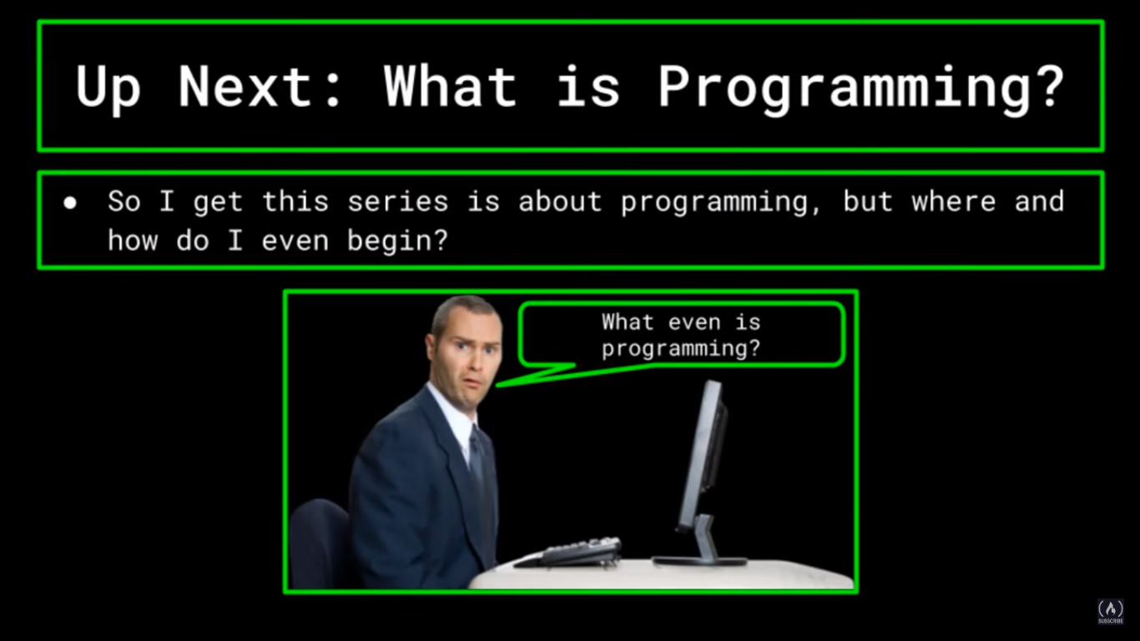

Slide 3
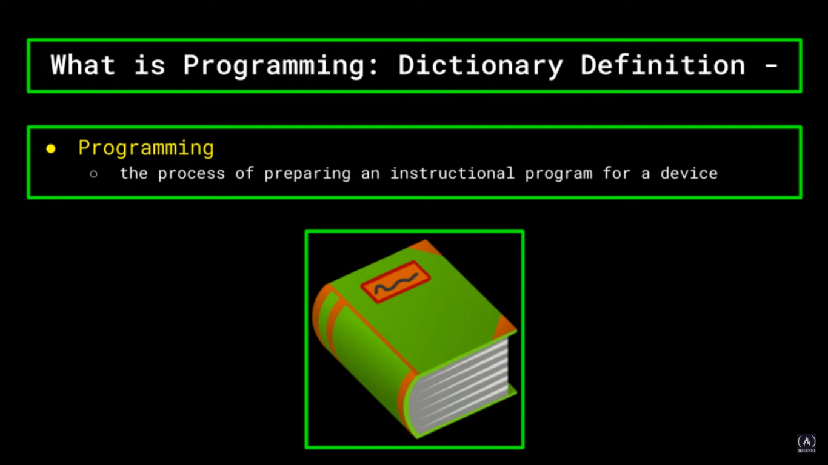

Slide 4
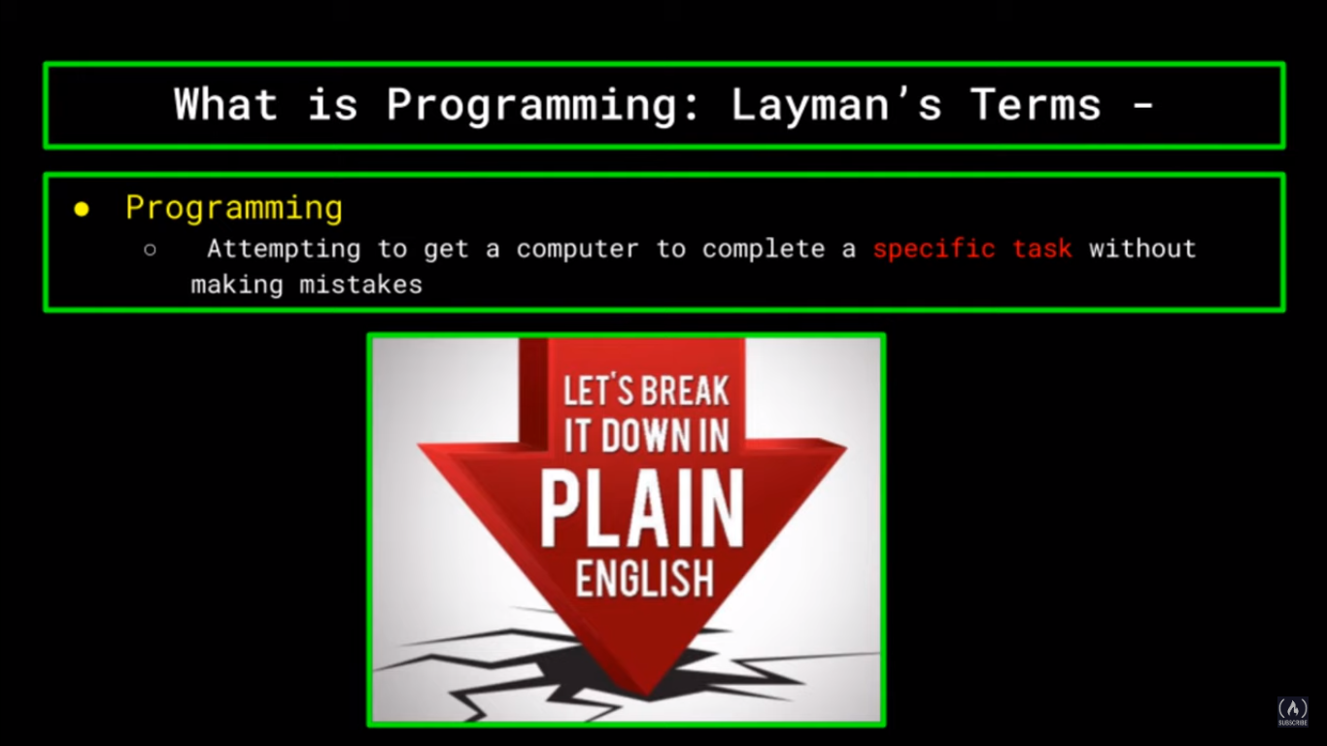

Slide 5
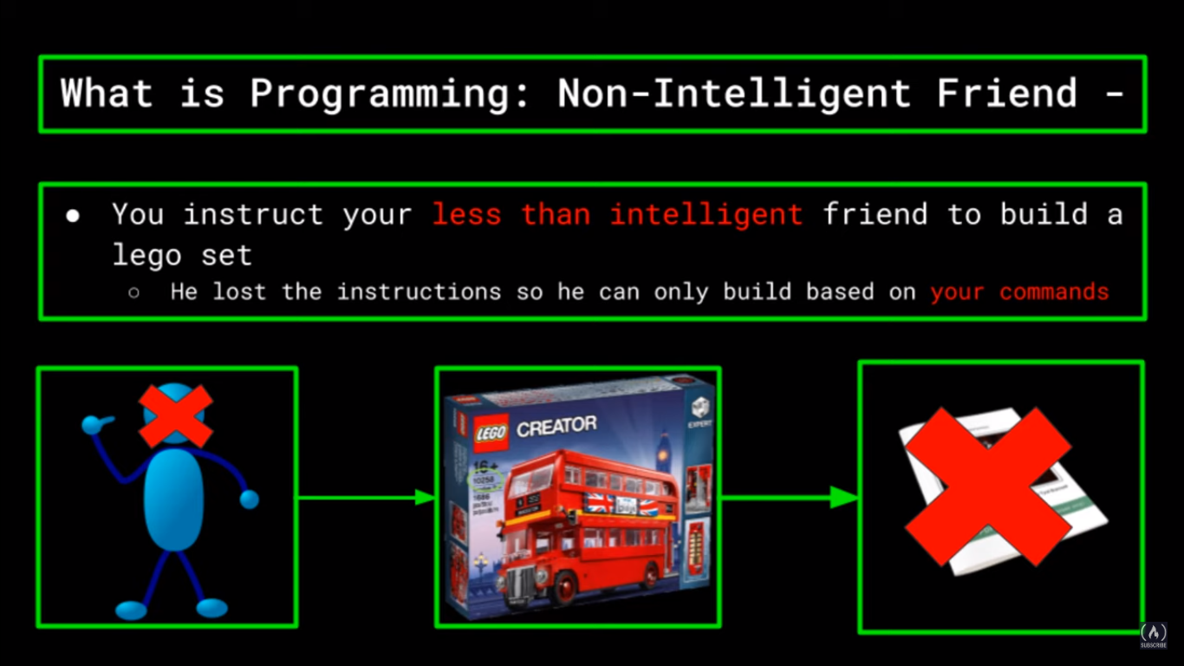

Slide 6
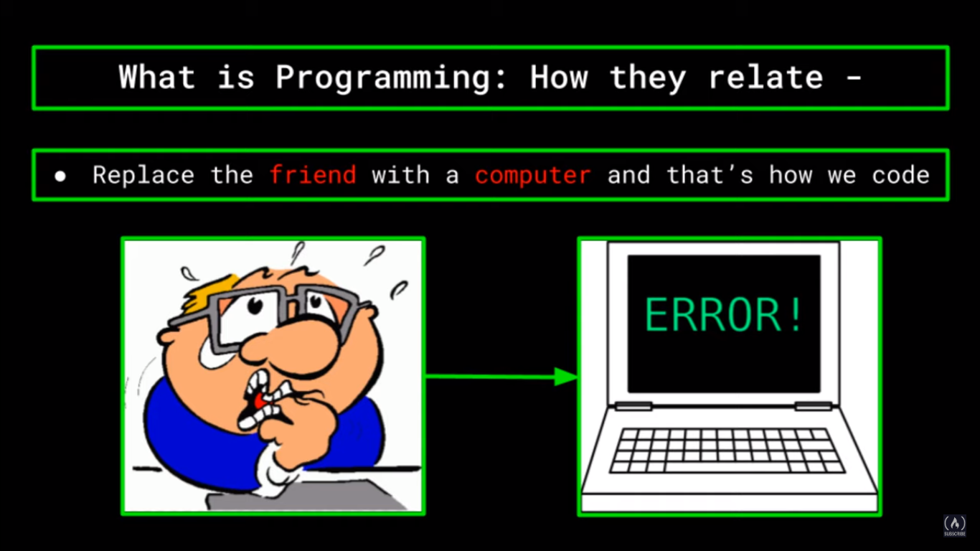

Slide 7
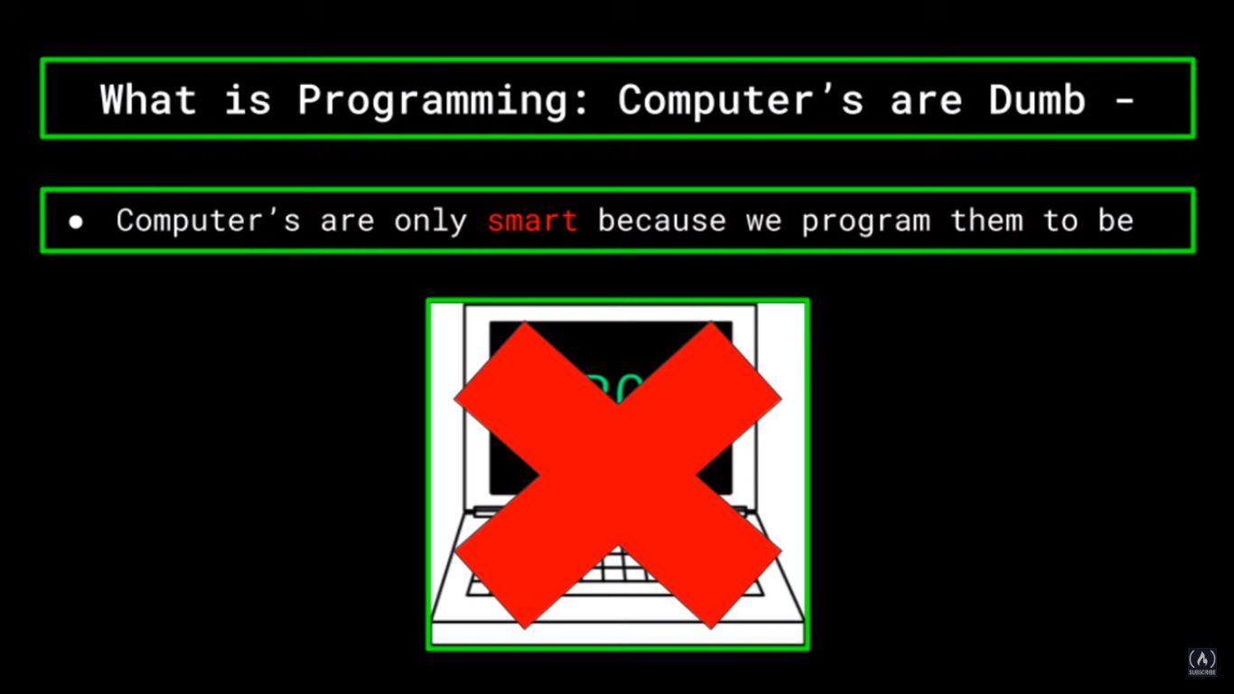

Slide 8
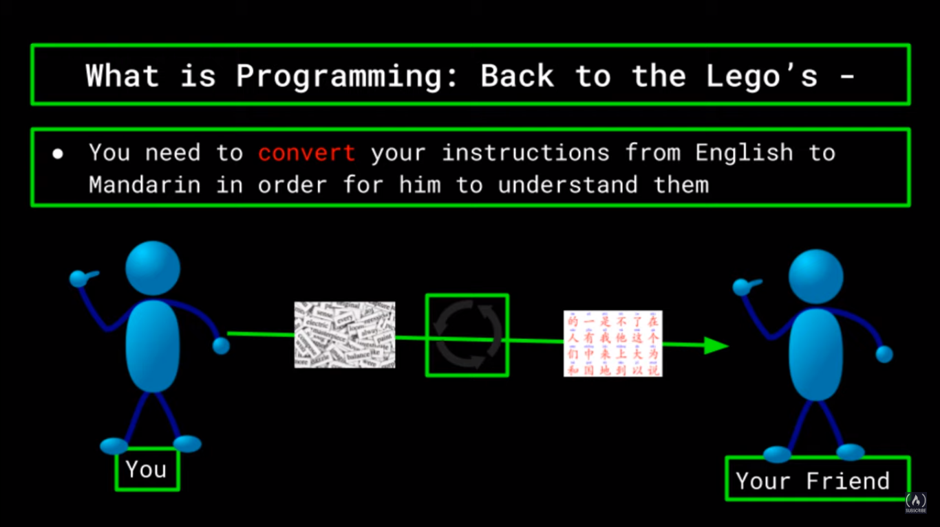

Slide 9
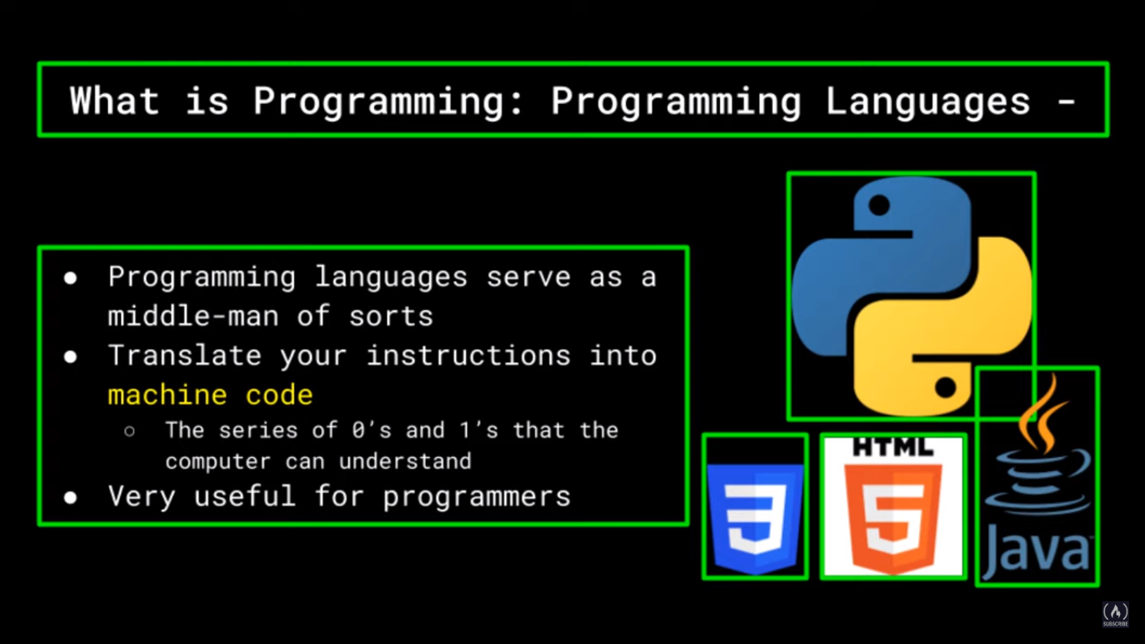

Slide 10
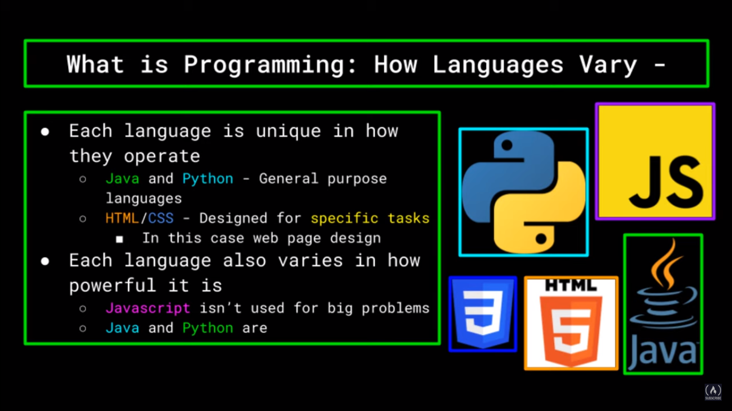

Slide 11
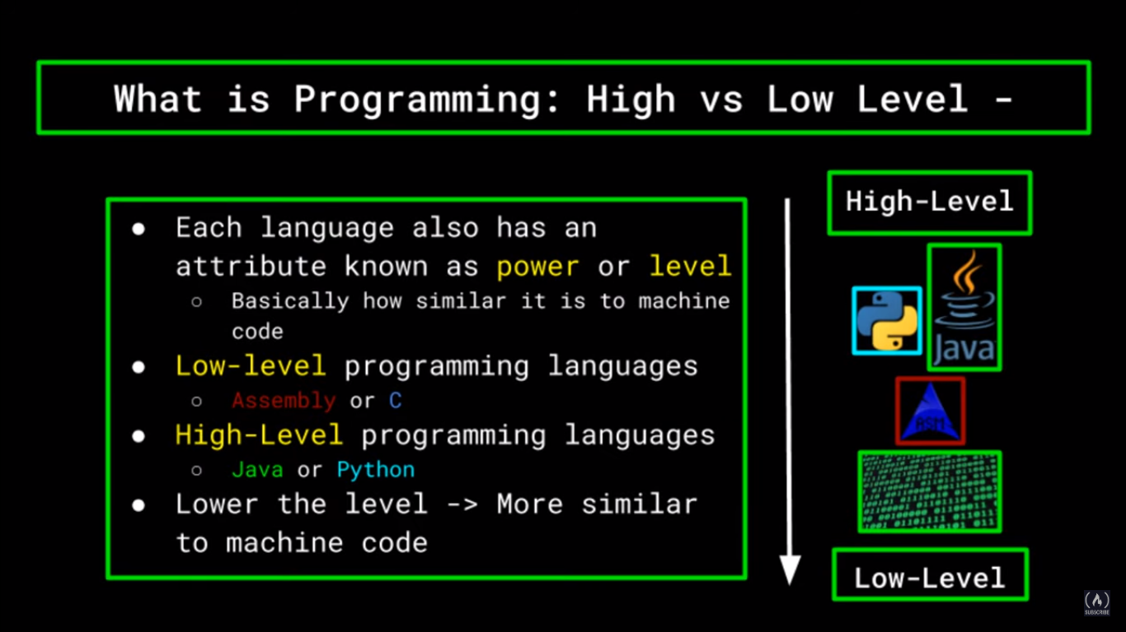

Slide 12
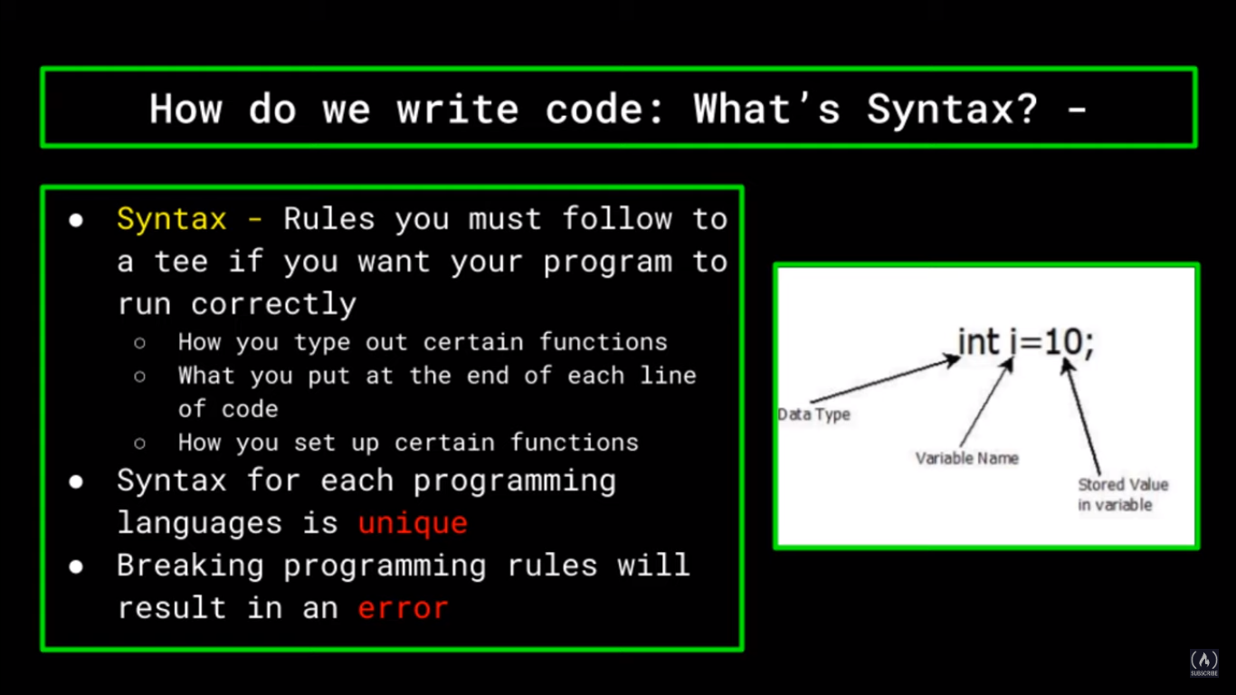

Slide 13
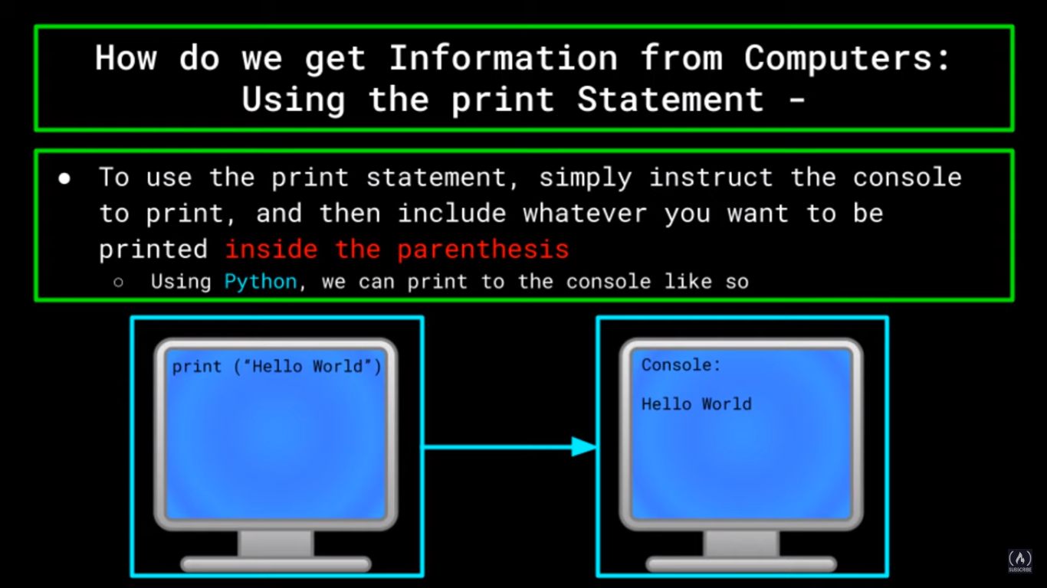

Slide 14
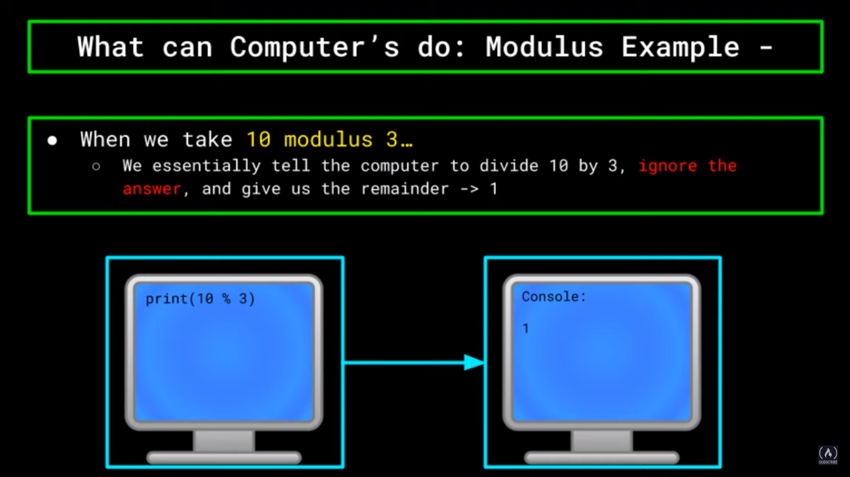

Slide 15
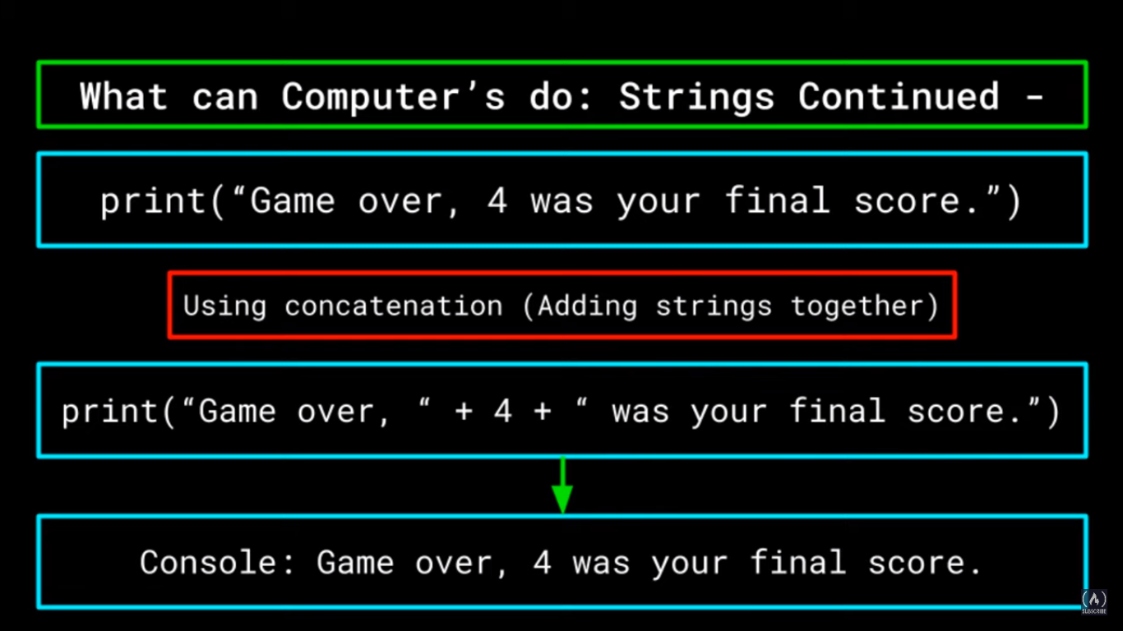
print(“Game over, ” + “4” + “ was your final score”

Slide 16
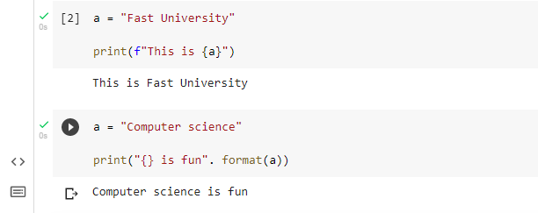
Python f string and format method

Slide 17
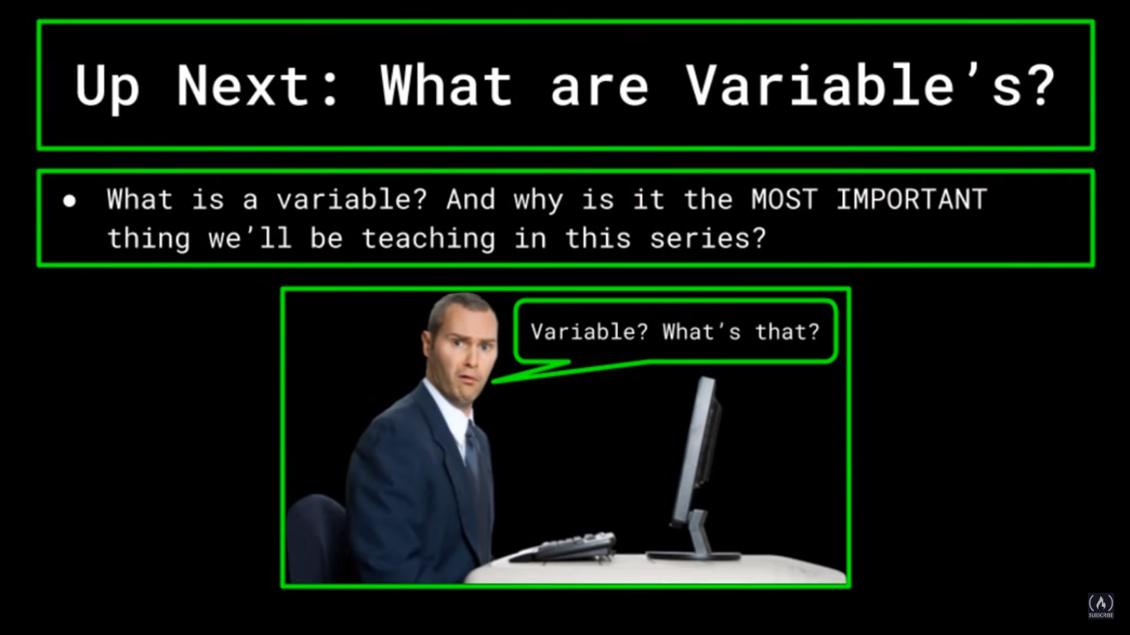

Slide 18
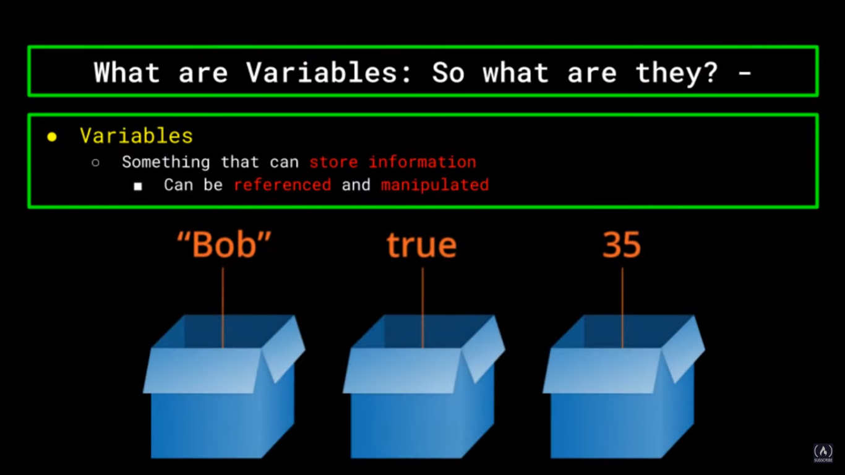

Slide 19
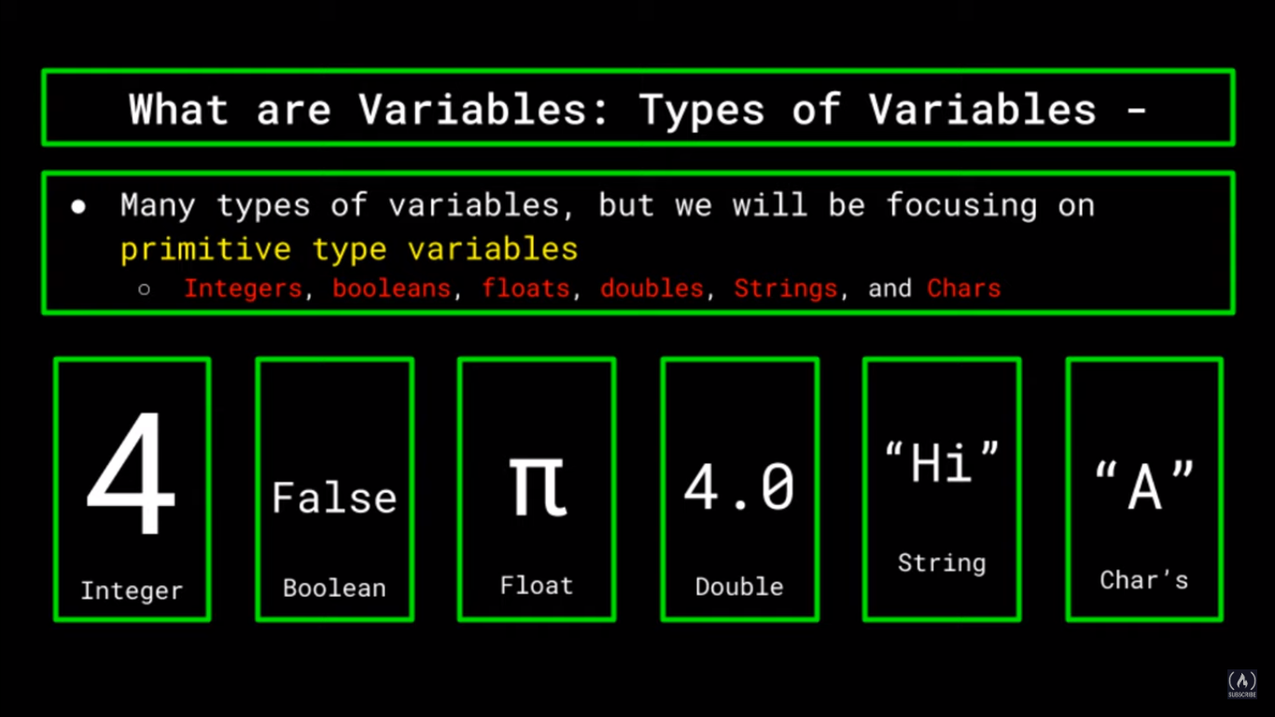

Slide 20
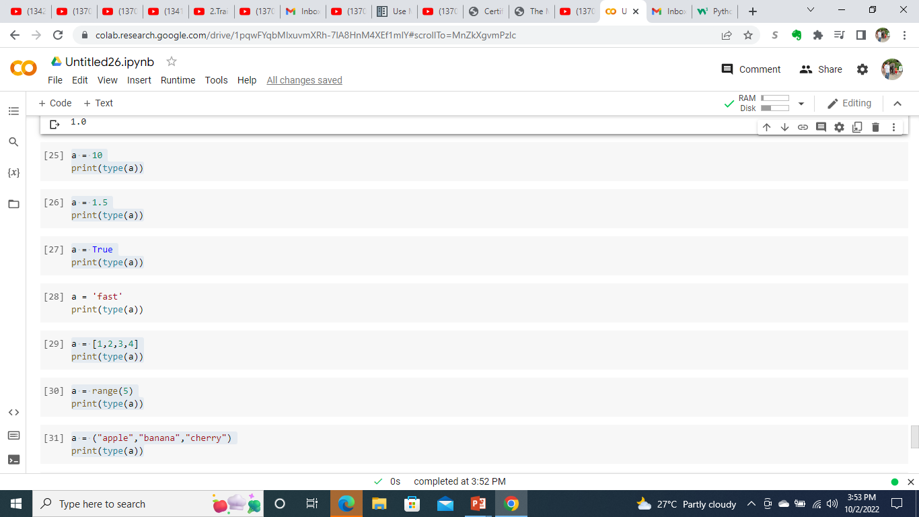
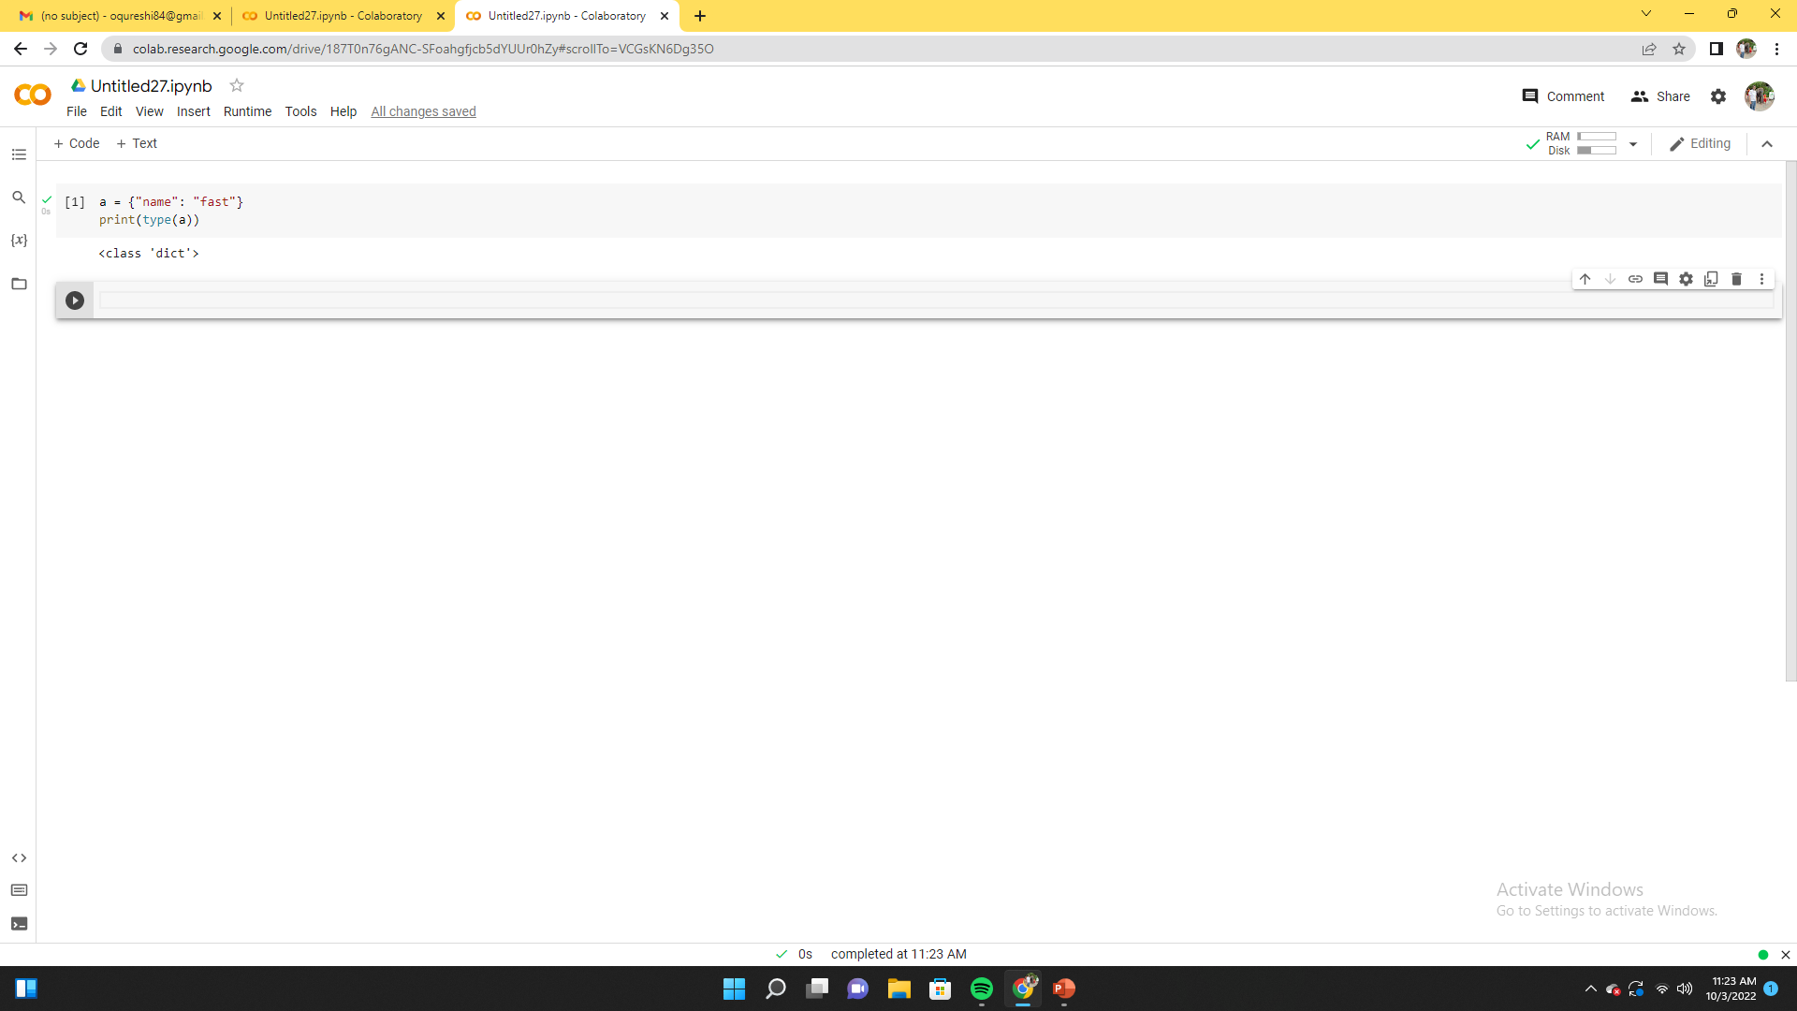
Python data types

Slide 21
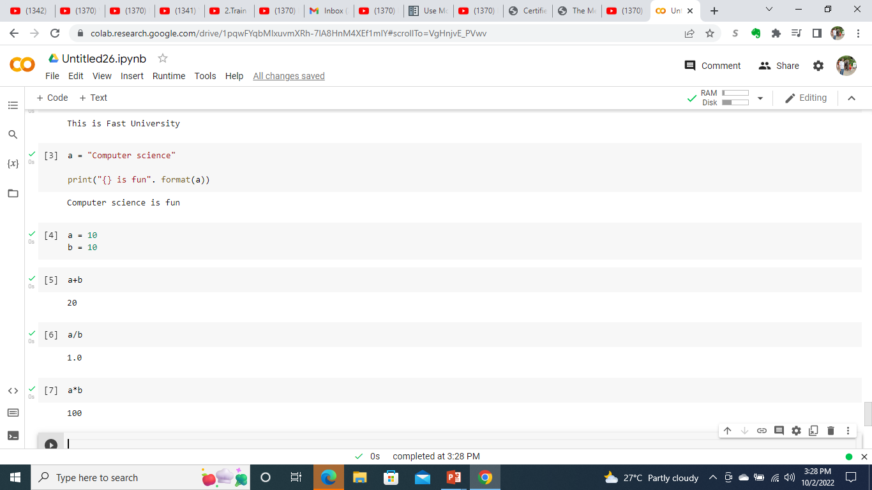
Python Variables - Integers

Slide 22

Python Variables - Float

Slide 23
Python Variables - Boolean
print(10 > 9)
print(10 == 9)
print(10 < 9)

Slide 24
Python List
this_list = ["apple", "banana", "cherry", "apple", "cherry"] print(this_list)
thislist = ["apple", "banana", "cherry"] print(thislist[1])
thislist = ["apple", "banana", "cherry"] print(thislist[-1])
thislist = ["apple", "banana", "cherry", "orange", "kiwi", "melon", "mango"] print(thislist[2:5])

Slide 25
Python List continued
thislist = ["apple", "banana", "cherry", "orange", "kiwi", "melon", "mango"] print(thislist[2:])
thislist = ["apple", "banana", "cherry"] thislist[1] = "blackcurrant" print(thislist)
thislist = ["apple", "banana", "cherry"] thislist.append("orange") print(thislist)
thislist = ["apple", "banana", "cherry"] thislist.pop(1) print(thislist)
thislist = [100, 50, 65, 82, 23] thislist.sort() print(thislist)

Slide 26
Python Strings
a = "Hello" print(a)
a = "Hello, World!" print(a[1])
a = "Hello, World!" print(len(a))
txt = "The best things in life are free!" print("free" in txt)

Slide 27
Python Dictionary
thisdict = { "brand": "Ford", "model": "Mustang", "year": 1964 } x = thisdict["model"]
x = thisdict.keys()
thisdict = { "brand": "Ford", "model": "Mustang", "year": 1964 } thisdict["year"] = 2018

Slide 28
Python Dictionary continued
thisdict = { "brand": "Ford", "model": "Mustang", "year": 1964 } thisdict["color"] = "red" print(thisdict)
thisdict = { "brand": "Ford", "model": "Mustang", "year": 1964 } thisdict.pop("model") print(thisdict)

Slide 29
Python tuples
thistuple = ("apple", "banana", "cherry") print(thistuple[1])
thistuple = ("apple", "banana", "cherry") print(thistuple[-1])
x = ("apple", "banana", "cherry") #update y = list(x) y[1] = "kiwi" x = tuple(y) print(x)
thistuple = ("apple", "banana", "cherry") # add y = list(thistuple) y.append("orange") thistuple = tuple(y)

Slide 30
CONDITIONAL STATEMENTS

Slide 31
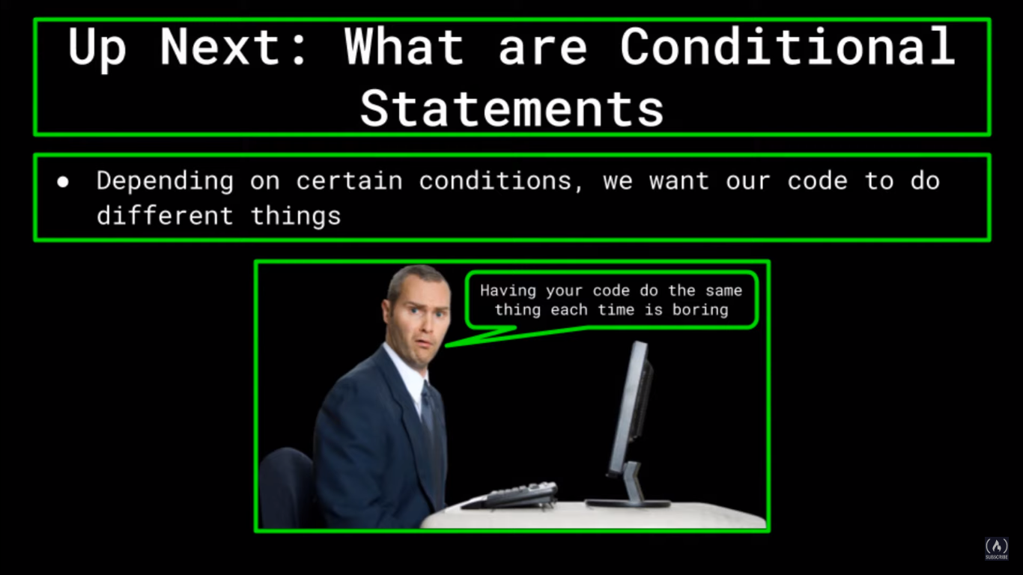

Slide 32
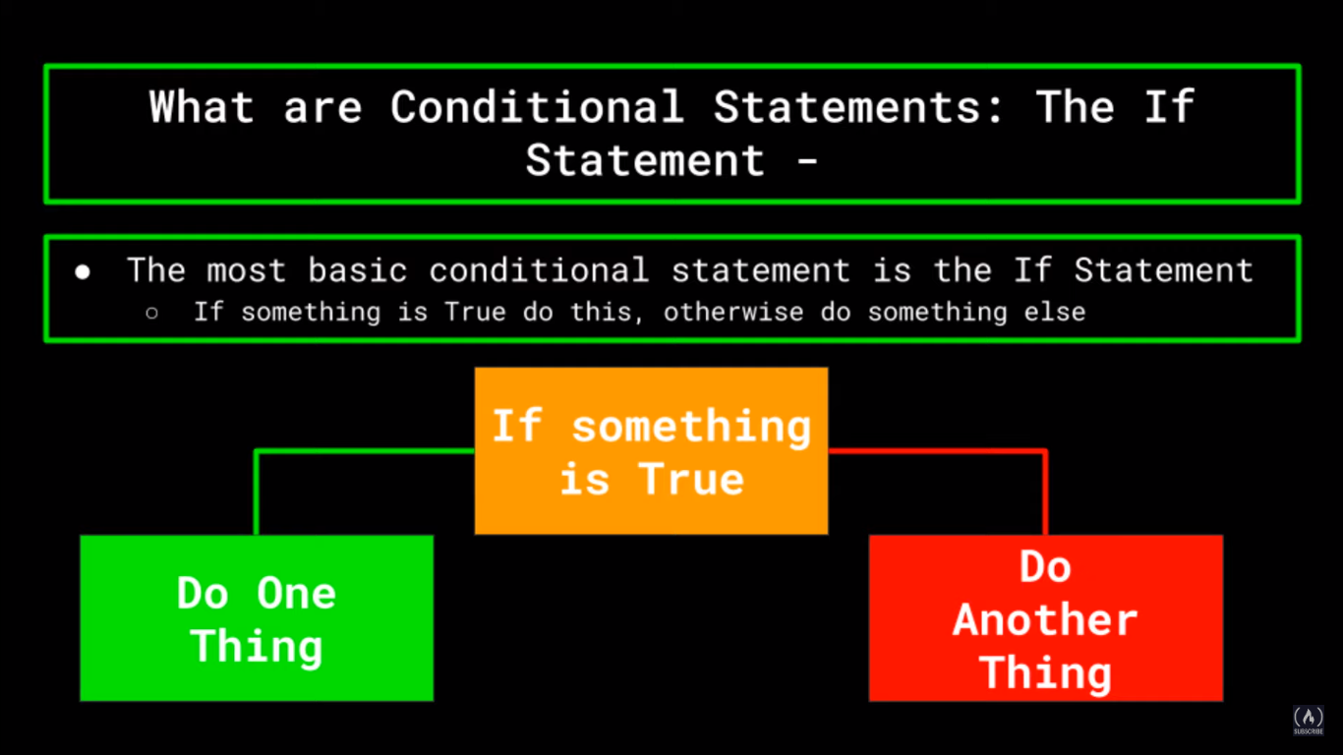

Slide 33
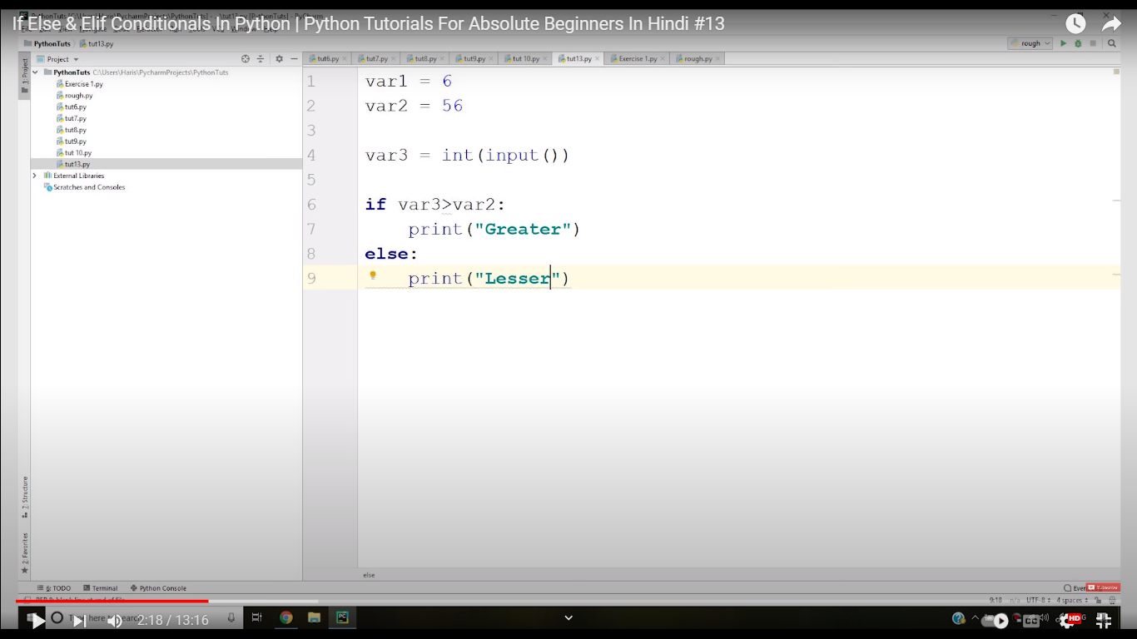
Python if else statement

Slide 34
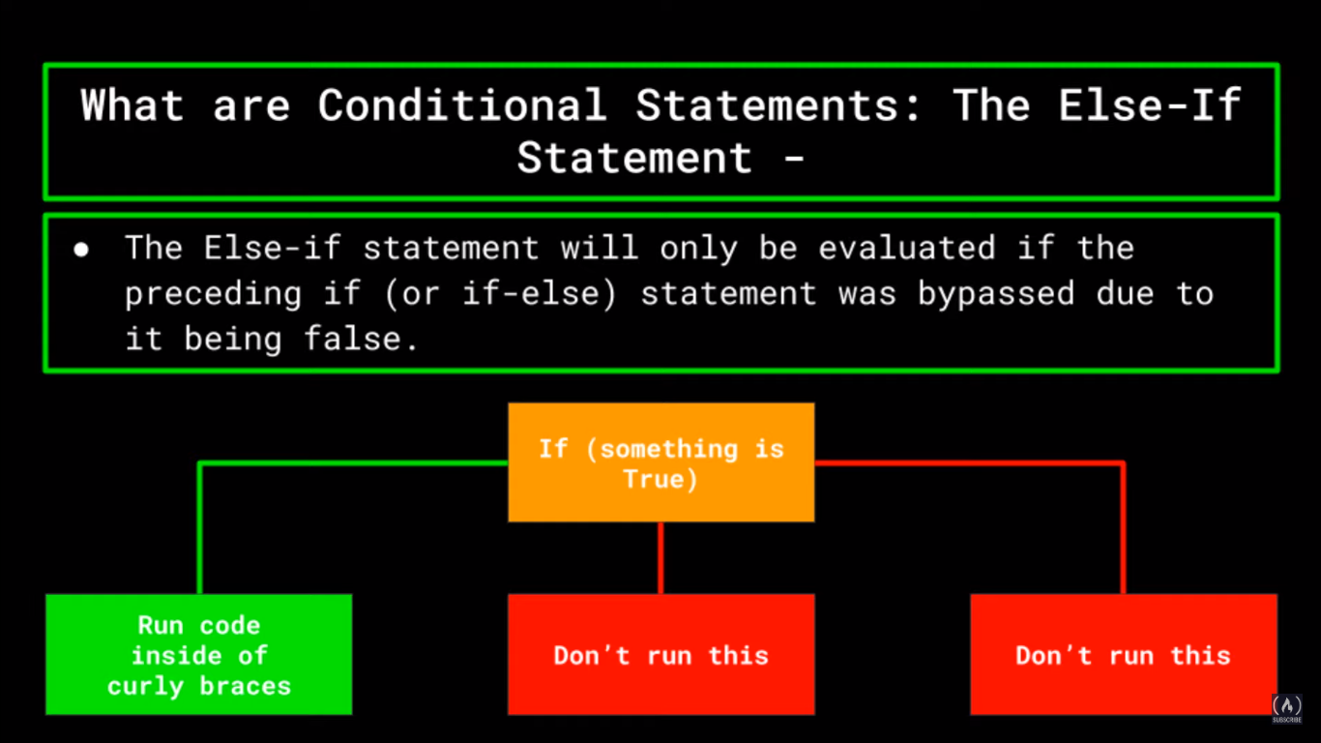

Slide 35
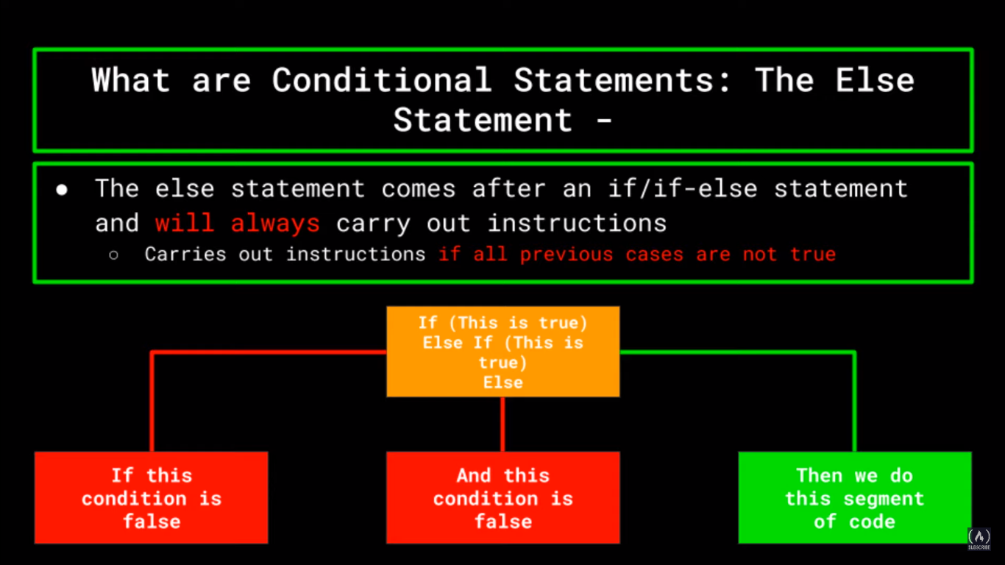

Slide 36
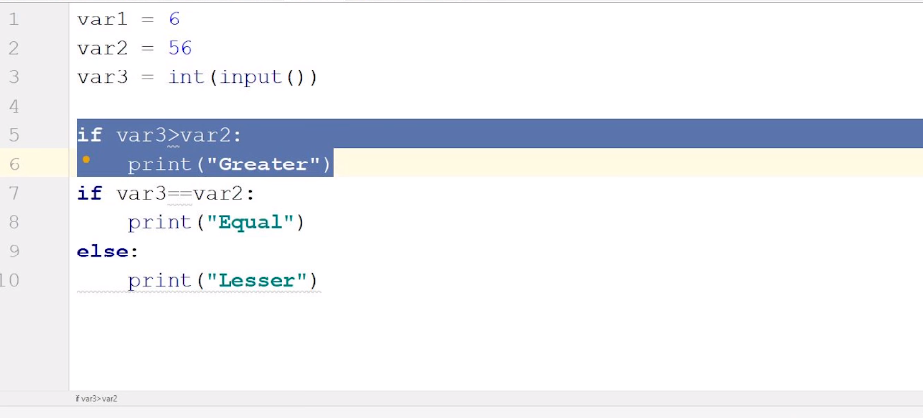
Multiple if statements

Slide 37
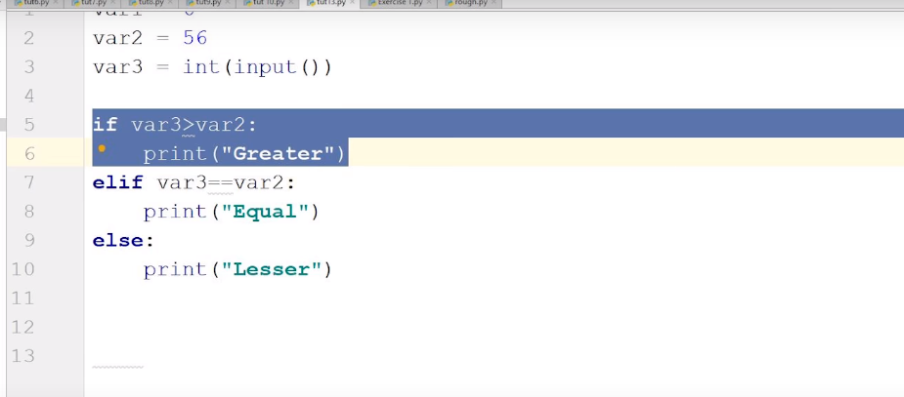
If else statement

Slide 38
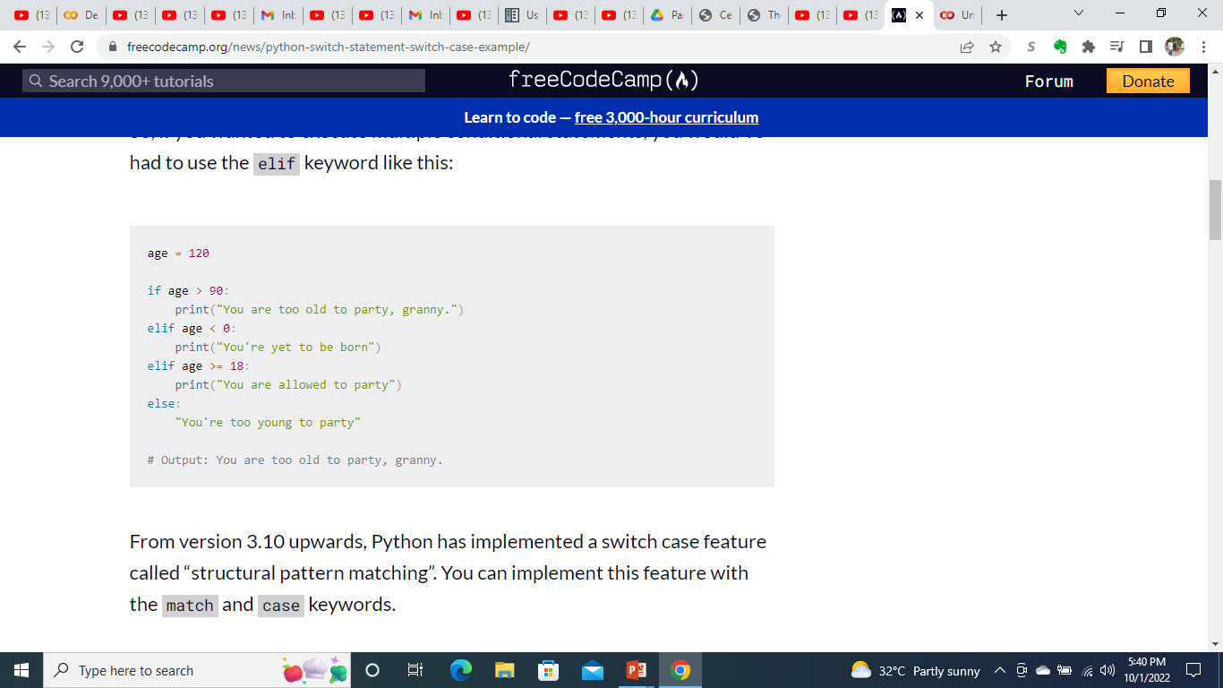
Practice

Slide 39
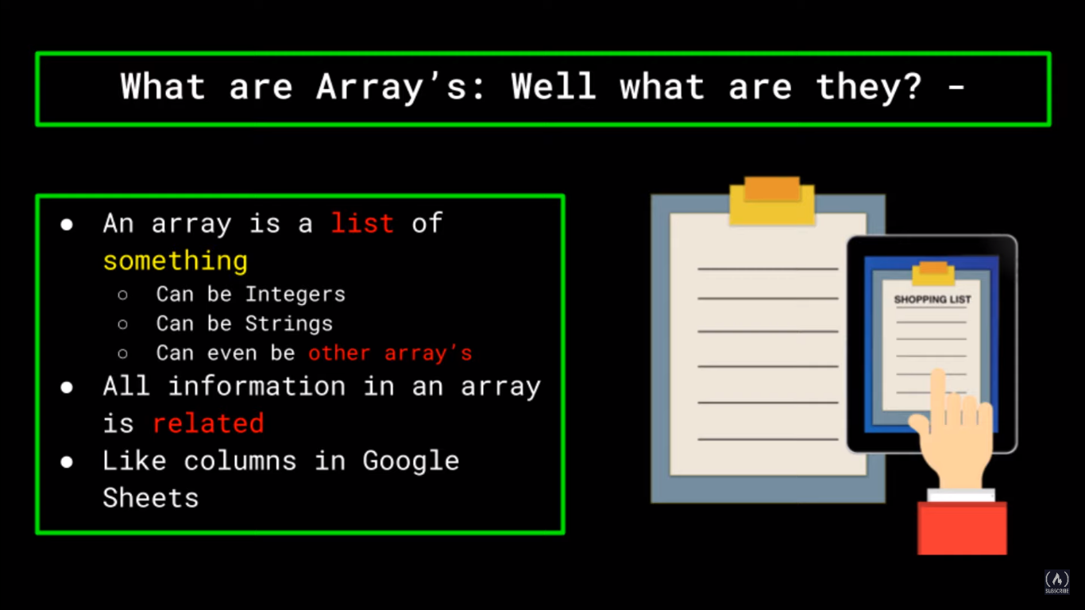

Slide 41
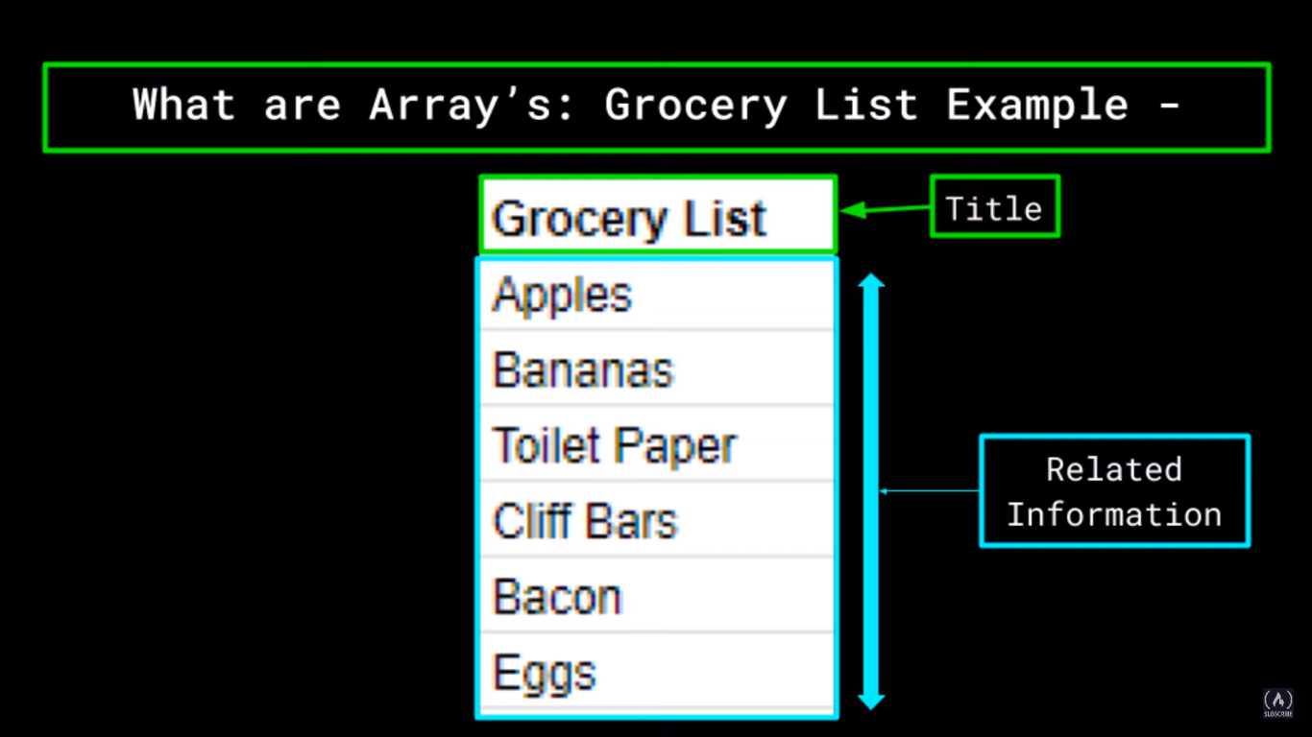

Slide 42
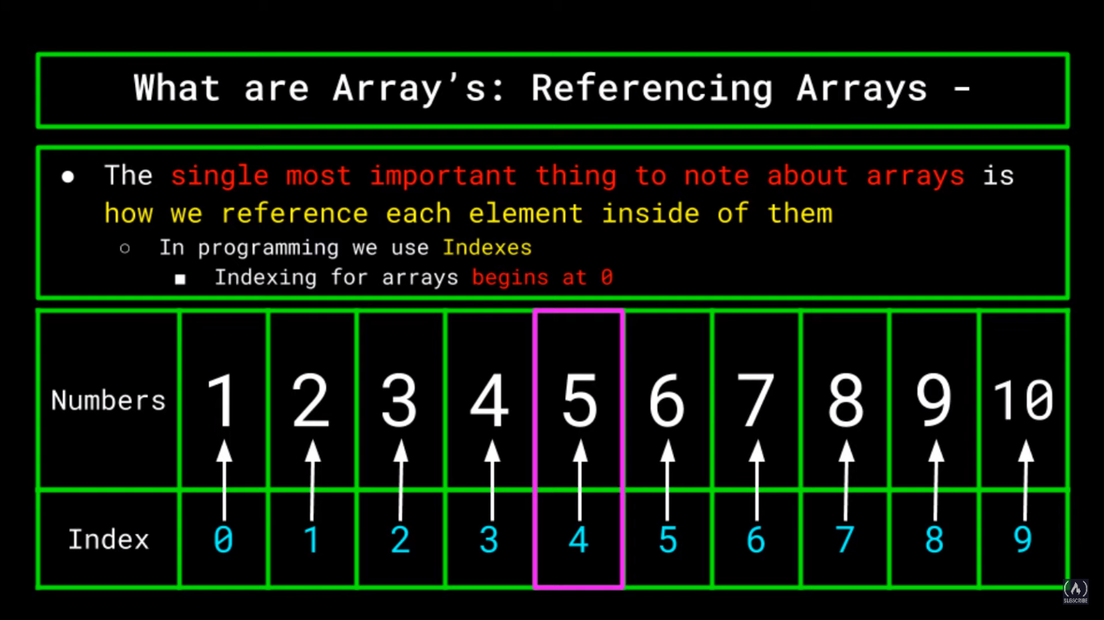

Slide 43
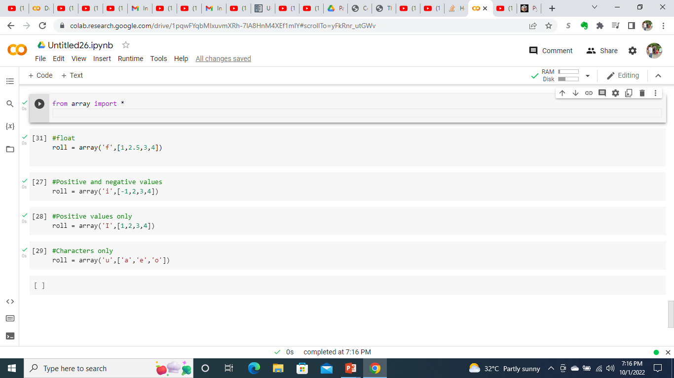
Creating arrays

Slide 44
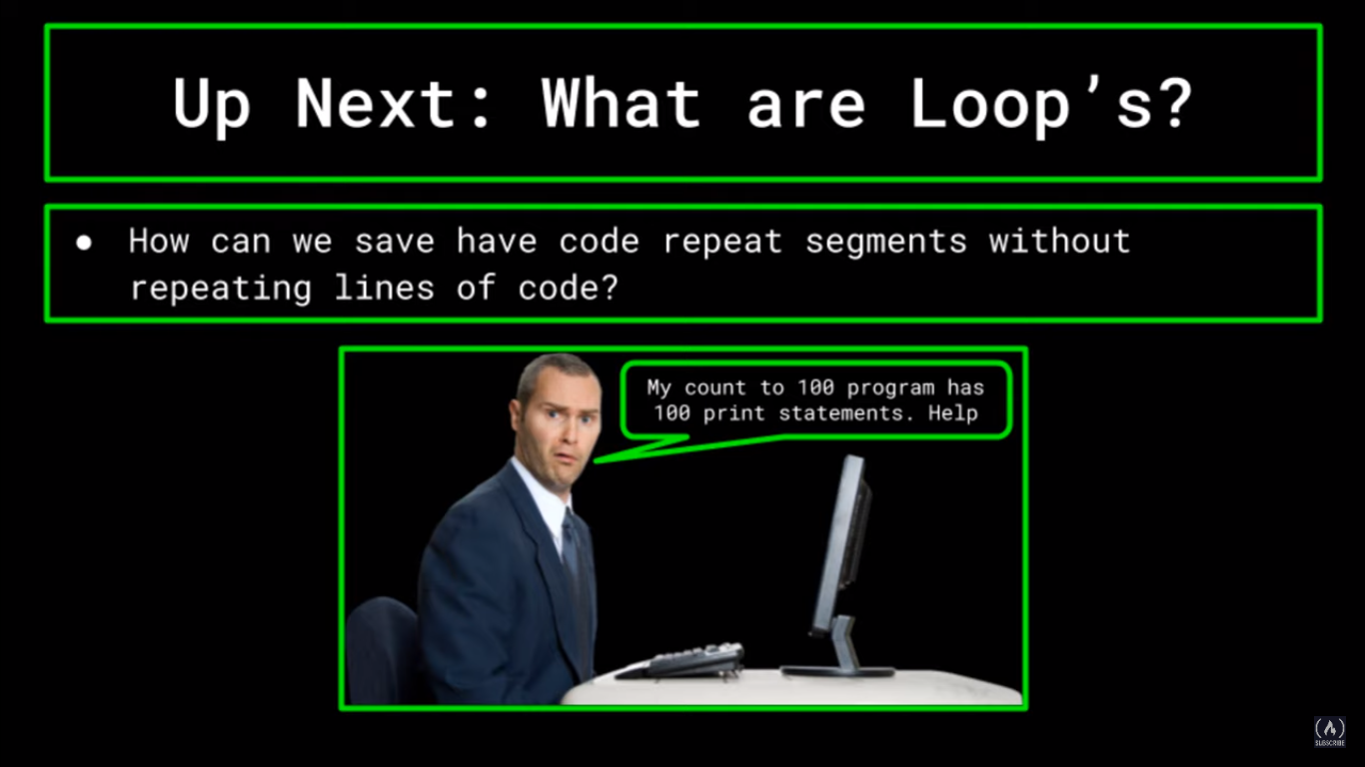

Slide 45
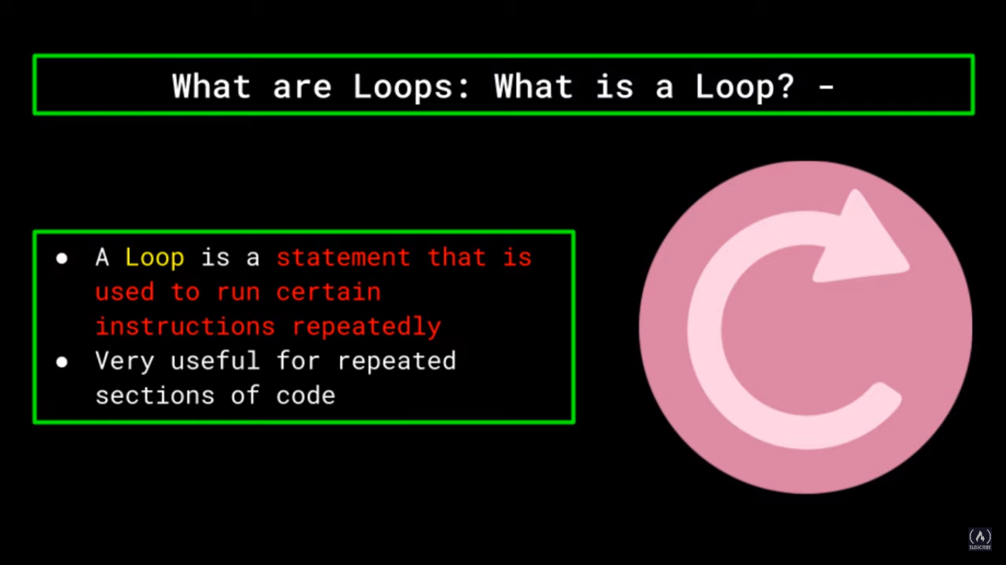

Slide 46
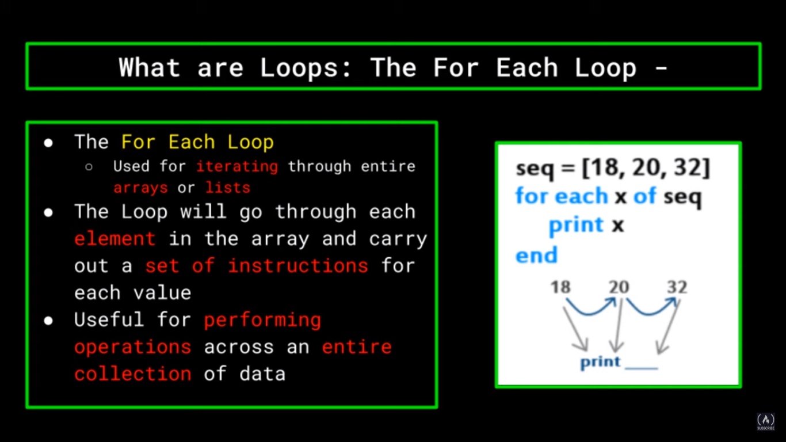
for x in seq:

Slide 47
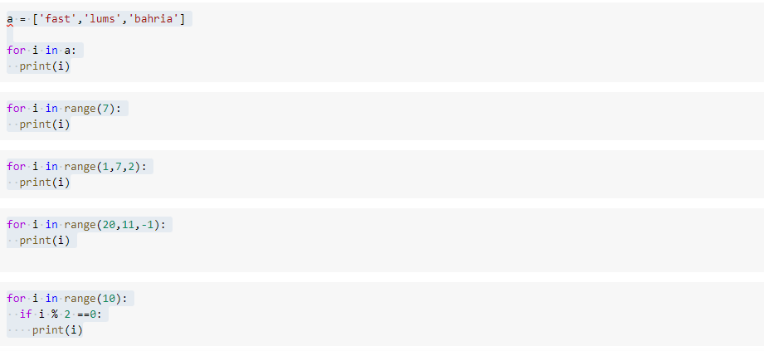
For loop in python

Slide 48
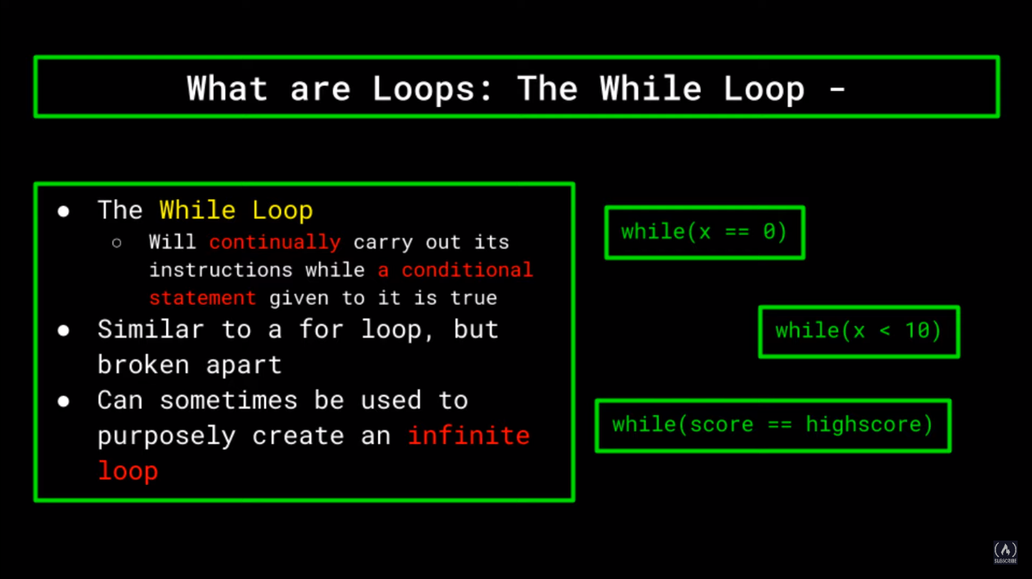

Slide 49
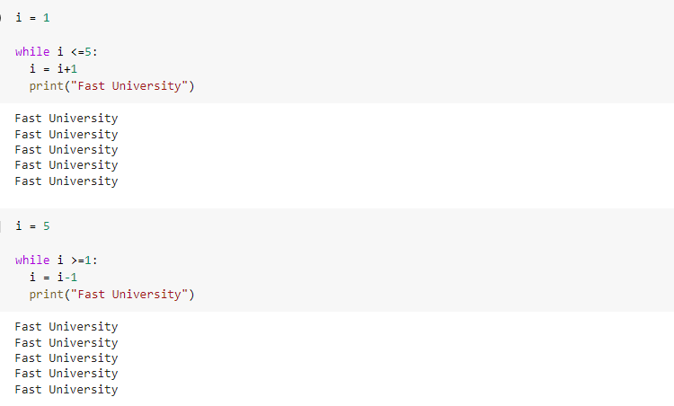
While loop

Slide 50
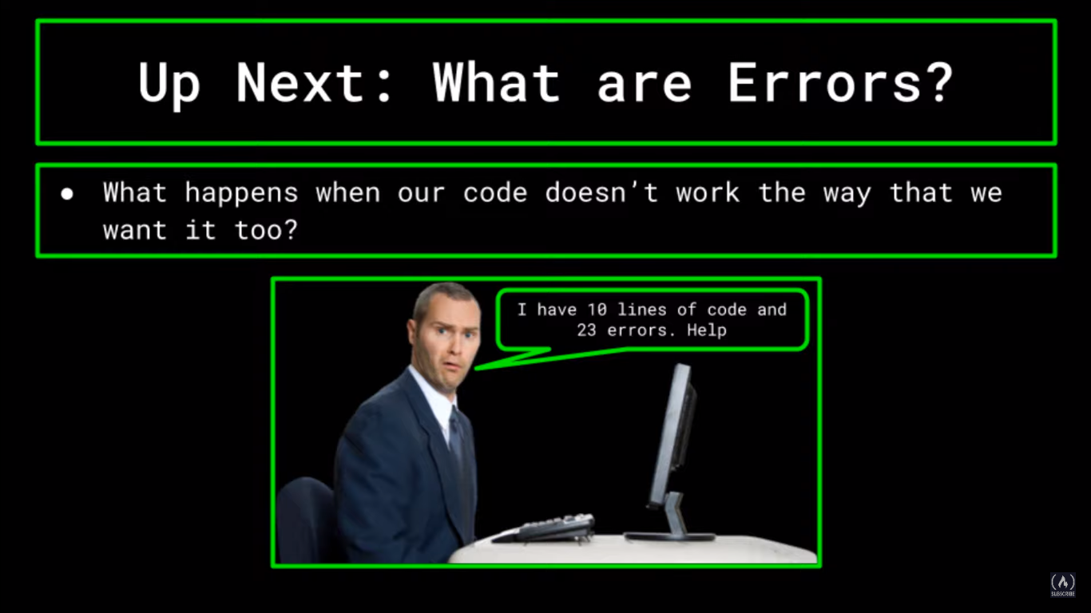

Slide 51
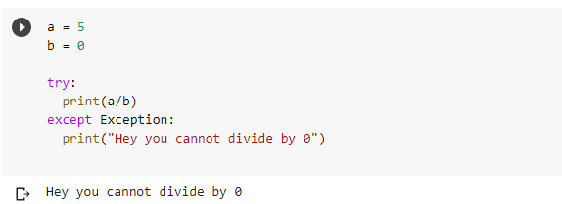
Try and except

Slide 52
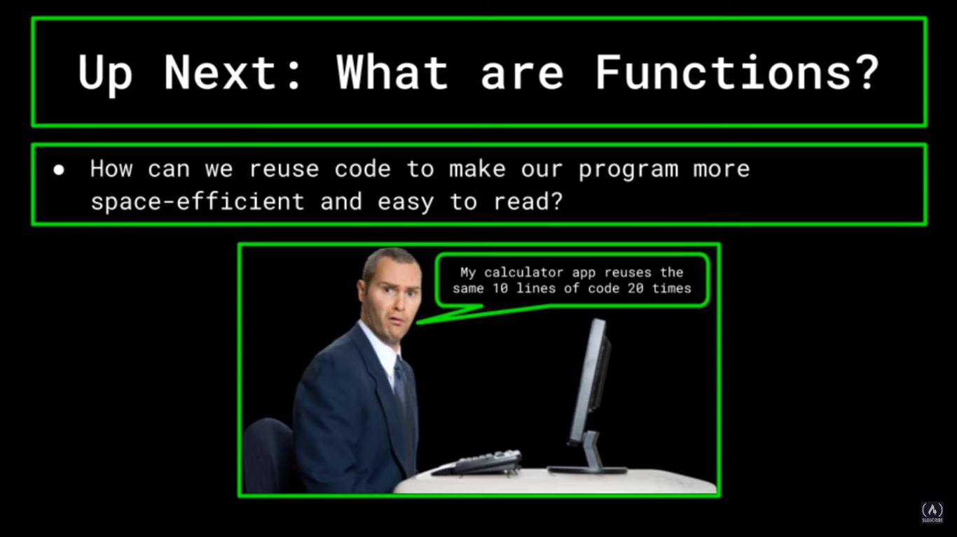

Slide 53
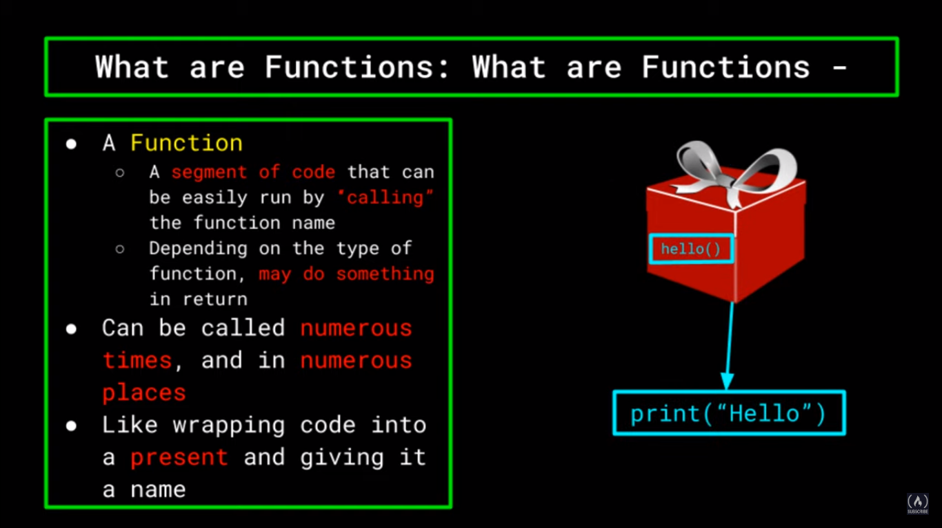

Slide 54
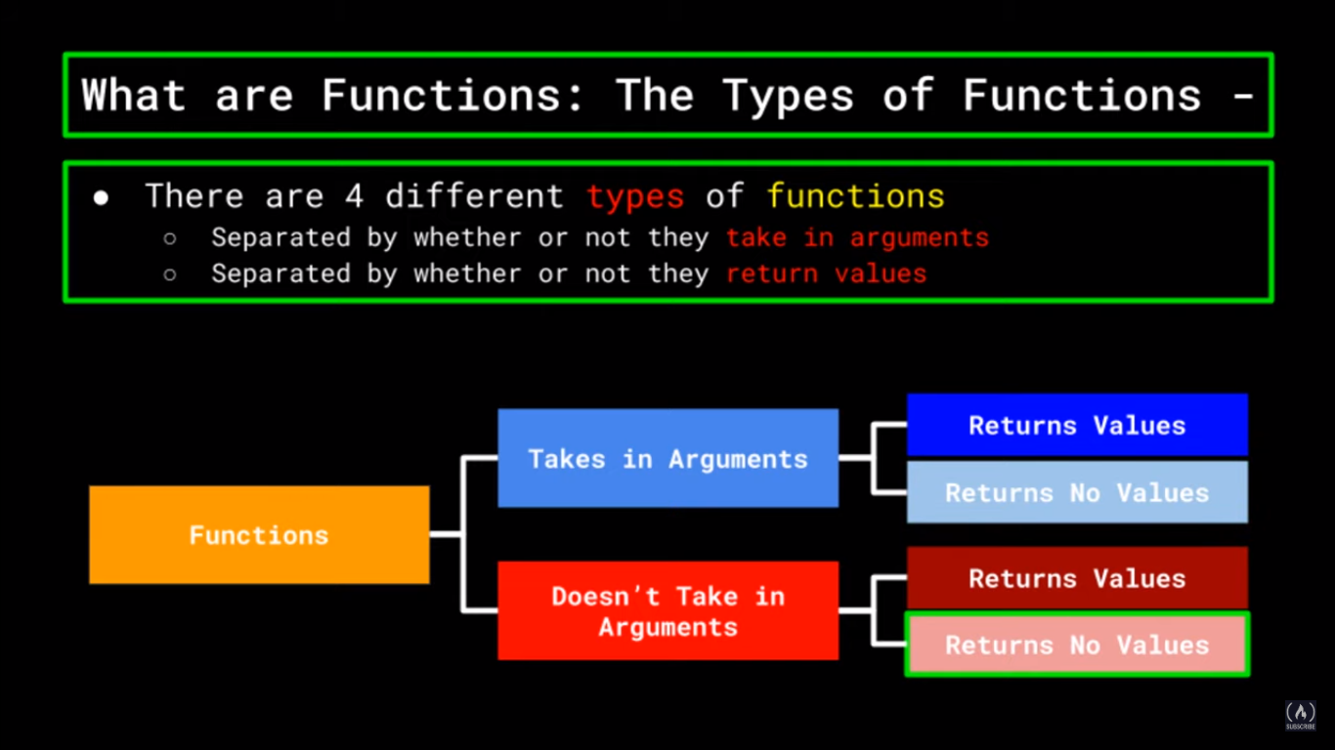

Slide 55
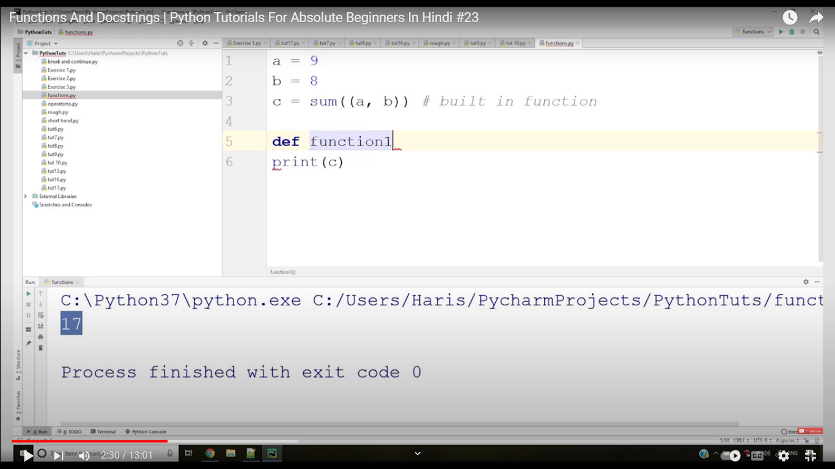
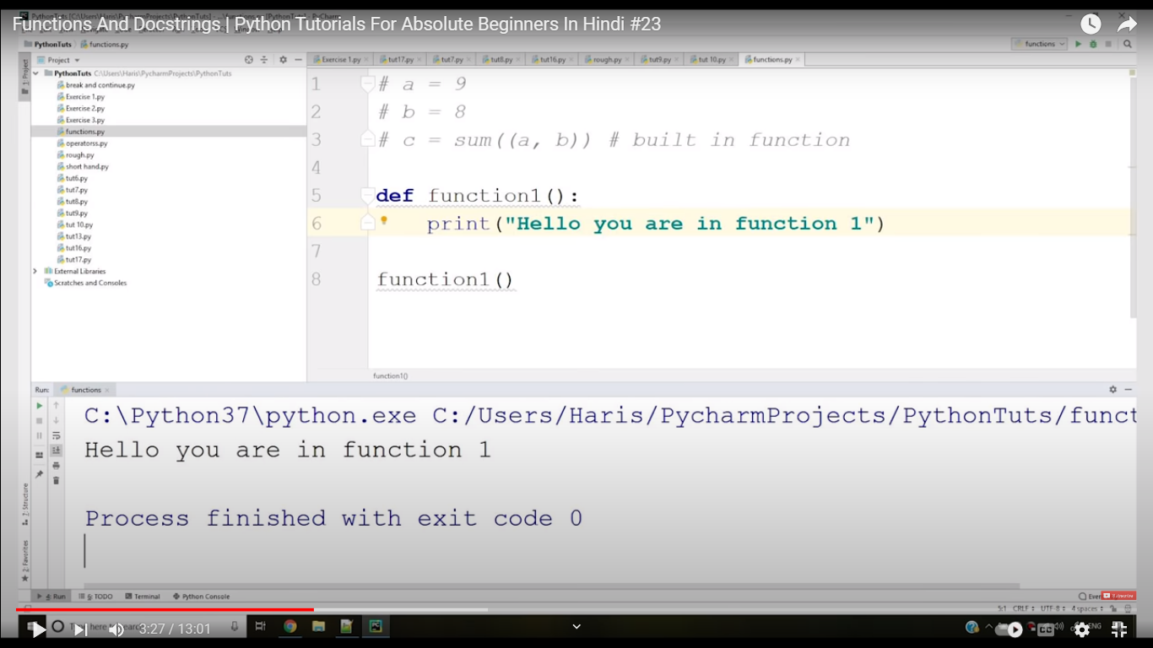
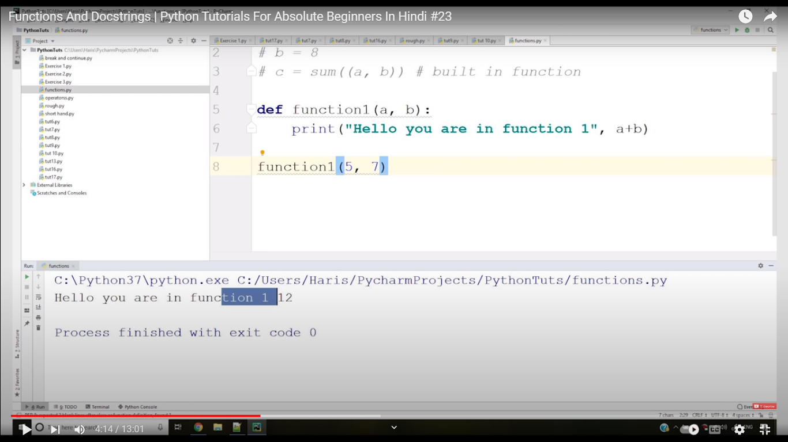
Functions in python

Slide 56
